Slide 1
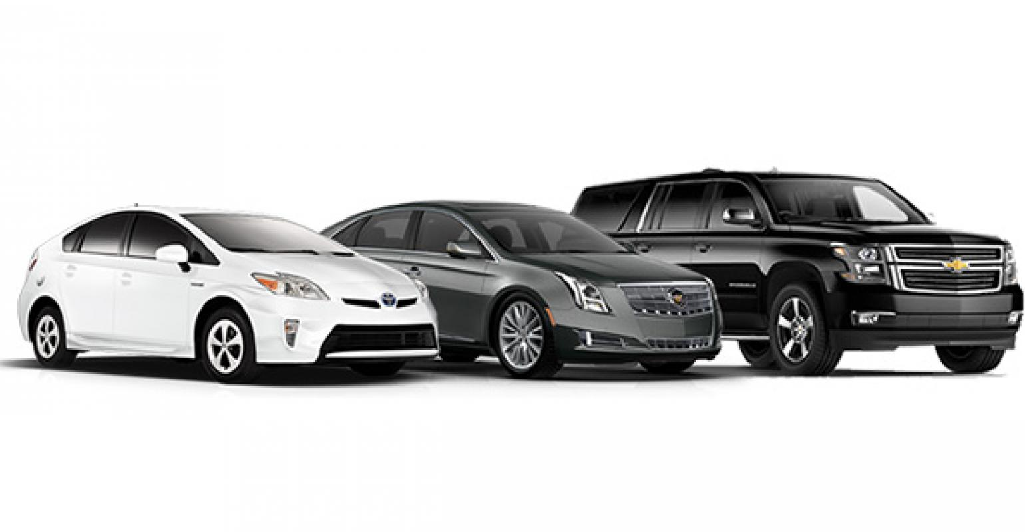
EDA on Automobile

Slide 2
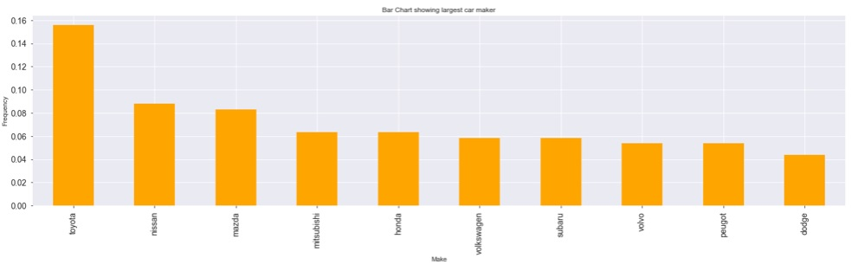
Who is the largest car maker?
Toyota is the largest car maker with nearly 16% followed by Nissan with 9%

Slide 3
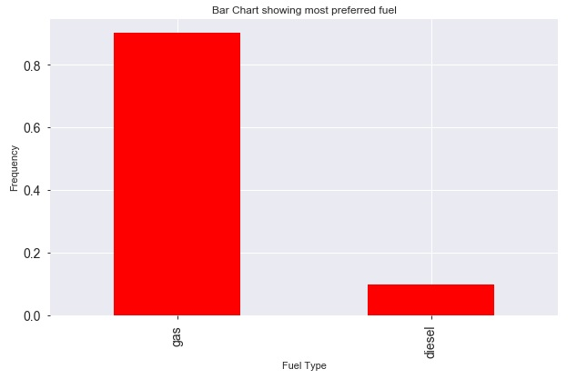
Which is the most preferred fuel?
Gas is used as fuel in 90% of automobiles

Slide 4
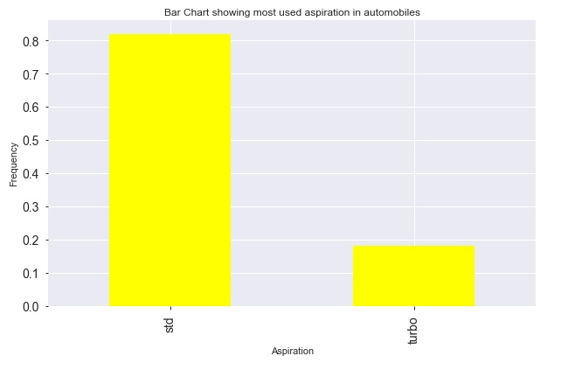
Which aspiration is mostly used?
Around 82% of automobiles have aspiration std

Slide 5
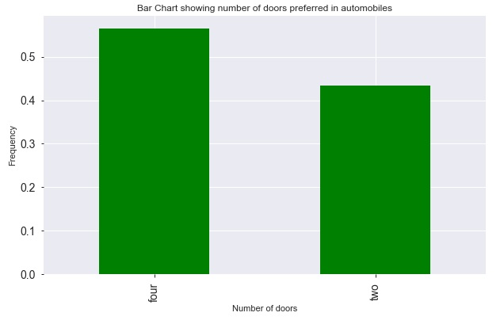
Number of doors preferred in cars
Maximum of automobiles have four doors with 56%

Slide 6
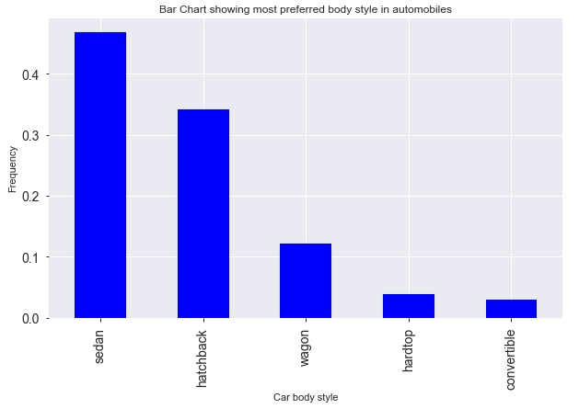
What is the body style in maximum number of cars?
Automobiles have body style of sedan with 47% followed by hatchback with 34%

Slide 7
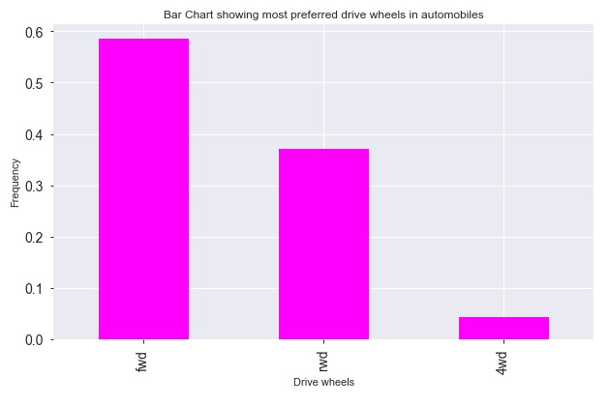
Most preferred drive wheels in cars
Most preferred drive wheels in automobiles is fwd with more than 55% followed by rwd with more than 35%

Slide 8
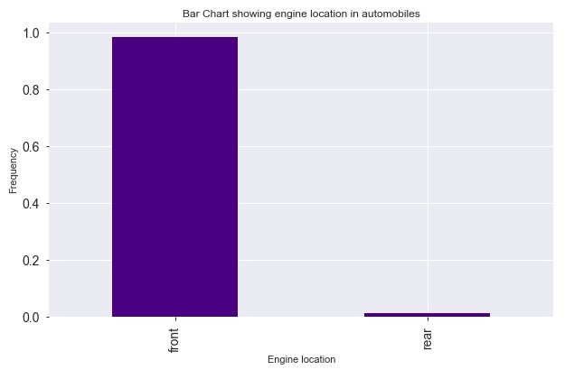
Most preferred engine location in automobiles
Most of the automobiles have engine location at the front with more than 95%

Slide 9
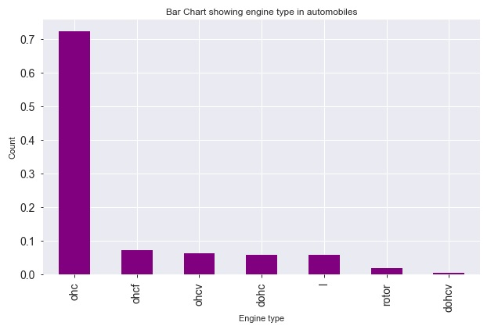
Most preferred engine type in automobiles
Most of the automobiles have engine type ohc with more than 70%

Slide 10
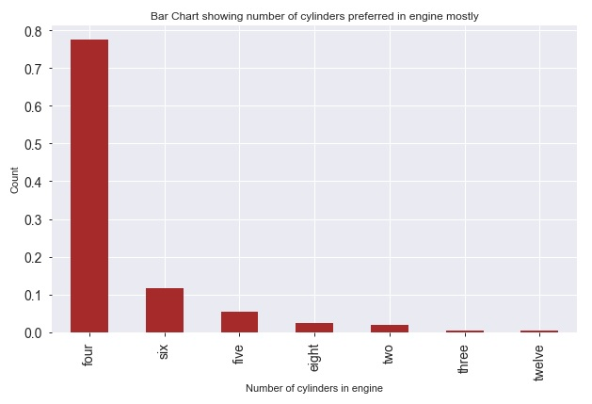
Most preferred number of cylinders in engine
Automobiles mostly prefer four cylinders engine with more than 75%

Slide 11
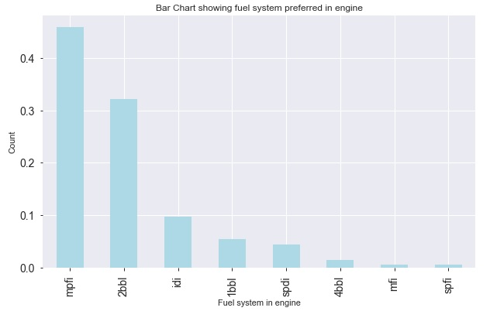
Most preferred fuel system in engine
More than 45% of automobiles have mpfi fuel system in engine followed by 2bbl fuel system in more than 30% of automobiles

Slide 12
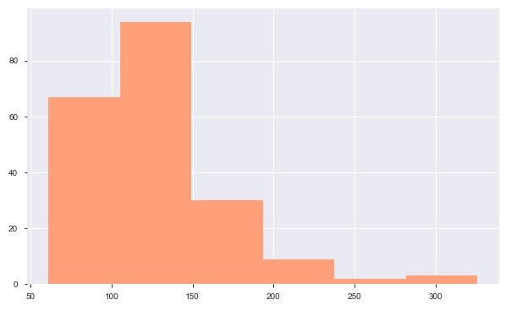
Range of engine size in automobiles
Most of the automobiles have engine-size between 60 to 190

Slide 13
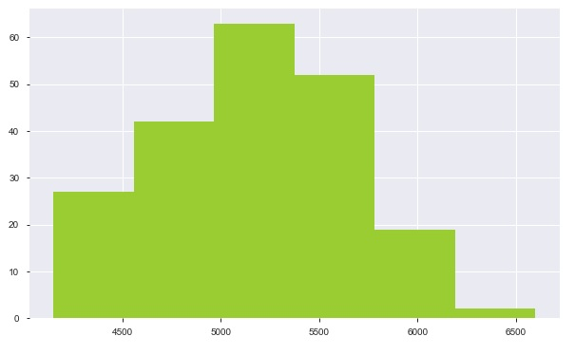
Range of peak rpm in automobiles
peak-rpm mostly distributed between 4550 to 5750

Slide 14
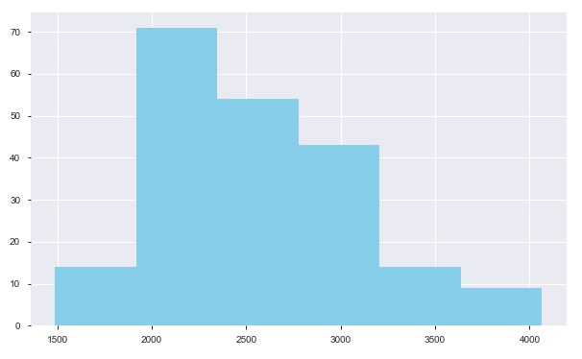
Range of curb weight in automobiles
Most of the vehicles curb-weight in the range 1900 to 3200

Slide 15
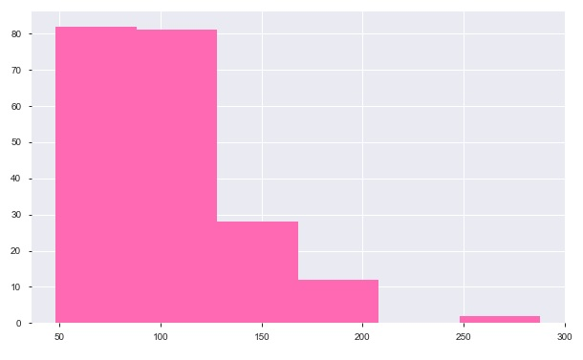
Range of horsepower in automobiles
Most of the vehicles has horse-power in the range 50 to 125

Slide 16
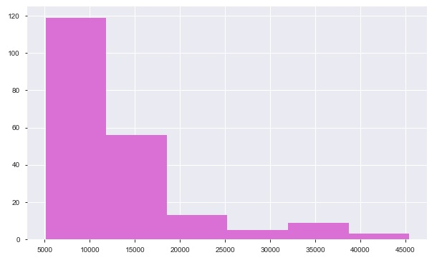
Range of price in automobiles
Most of the vehicles price between 5000 to 18000

Slide 17
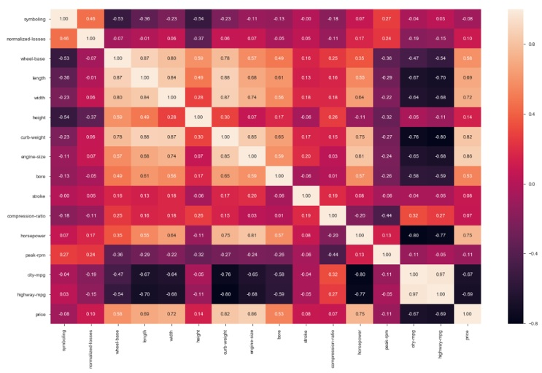
Correlation analysis
city-mpg, highway-mpg are highly correlated
curb-weight, engine-size and horsepower are positively correlated

Slide 18
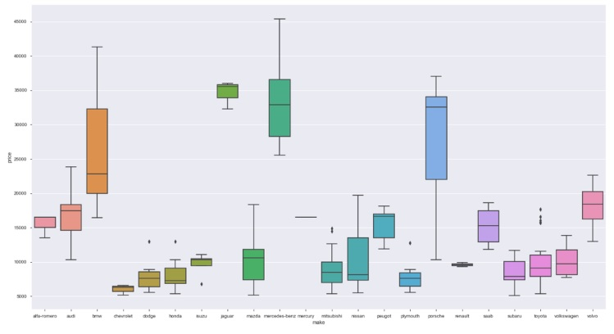
Price based on make
Mercedez-Benz, BMW, Jaguar, Porshe produces expensive cars more than 20000
Cheverolet, dodge, honda, mitbushi, nissan, plymouth, subaru, toyata produces budget cars with lower prices
Most of the automobile comapany produces car in range below 20000

Slide 19
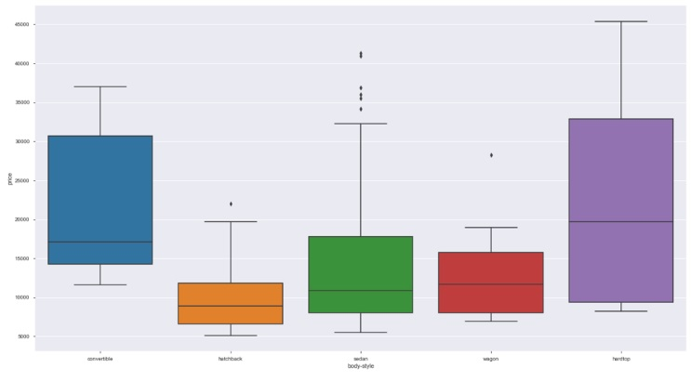
Price based on body-style
Hardtop model is expensive in prices followed by convertible and sedan body style
Hatchback and wagon are low priced vehicles

Slide 20
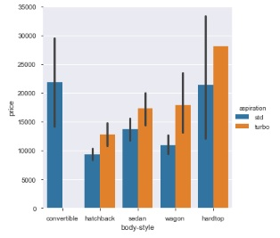
Price based on body-style and aspiration
Turbo models are expensive compared to standard models
Convertible has only standard edition with expensive cars
hatchback, sedan and wagon turbo models are available below 20000

Slide 21
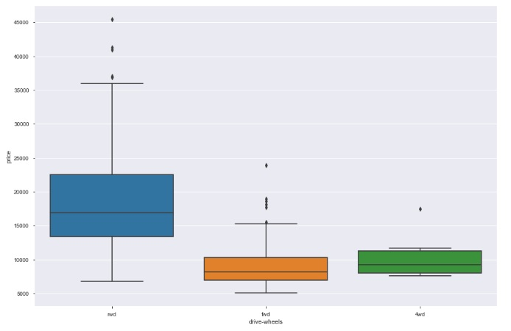
Price based on drive-wheels
rwd drive-wheels vehicles are expensive compared to fwd and 4wd
fwd and 4wd drive-wheels vehicles available in the price range of below 15000

Slide 22
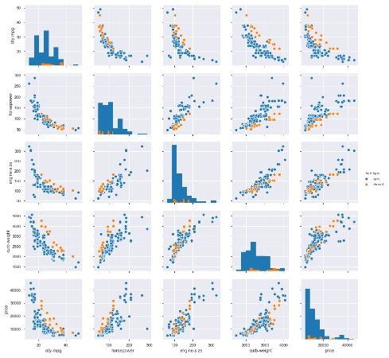
Price vs Automobile specifications
Vehicle Mileage decrease as increase in Horsepower, engine-size, curb-weight
As horsepower increases the engine-size increases
engine-size and curb-weight is positively correalted with price
city-mpg is negatively correlated with price as increase horsepower reduces the mileage

Slide 23
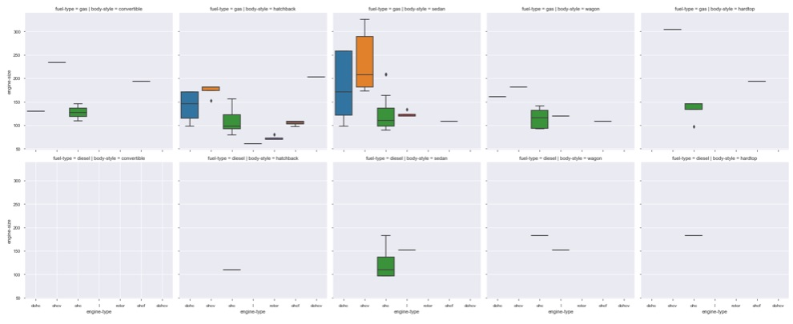
Engine size based on engine-type for body-style and fuel-type
ohc is the most used Engine Type both for diesel and gas
Diesel vehicle have Engine type ohc and I and engine size ranges between 90 to 190
Engine type ohcv has the bigger Engine size ranging from 170 to 340
Body-style Hatchback uses max variety of Engine Type followed by sedan
Body-style Convertible is not available with Diesel Engine type

Slide 24
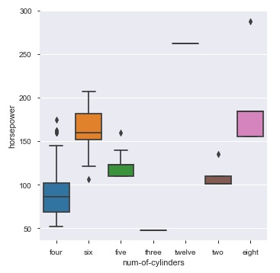
Horsepower based on num-of-cylinders
Vehicle with above 150 horsepower has Six, Eight, Twelve cyclinders
There are some four, five cyliner engines produces above 150 horsepower

Slide 25
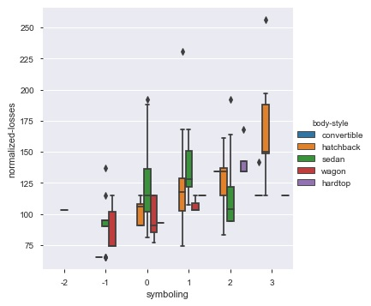
Normalized losses vs Symboling
Here +3 means risky vehicle and -2 means safe vehicle
Increase in risk rating linearly increases in normalised losses in vehicle
covertible car and hardtop car has hardly losses with risk rating above 0
hatchback cars has highest losses at risk rating 3
sedan and wagon car has losses even in less risk (safe)rating

